Slide 1
TECHNOLOGY ADVANCEMENT IN MEDICAL FIELD

Slide 2
Roll No. | Name | Batch
C032 | Aryan Mehta | B1
C034 | Reneeka Nadkarni | B2
C044 | Amishi Desai | B2
C049 | Chahel Gupta | B2
C056 | Aneri Patel | B2
C065 | Kirtan Thakkar | B2

Slide 3
TOPICS TO BE COVERED
Brain
Teeth
Bones
Transcranial magnetic stimulation
The BRAIN initiative
Stereoelectroencephalography
Magnetoencephalography
3D Printing
Robotic Dental Implant Surgery
Continuous Liquid Interface Production
Intra-Oral Camera
Robotic Surgeries
Orth biologic Technology
Smart Sensor-Enabled Technologies and Implants
3-D Printing Technology
.
Eyes
Heart
Internal Organs
Corneal Inlay May Soon Replace Reading Glasses
HIV Meds for Macular Degeneration
Apps for the Blind
.
Personalized heart models to aid surgery
Oral conformal electronics
Virtual and Augmented reality in cardiology
Engineered Heart valve
Technologies for Liver
Technologies for Stomach
Technologies for Kidneys
Technologies for Pancreas

Slide 4

Why do we need Advancements?

Slide 5
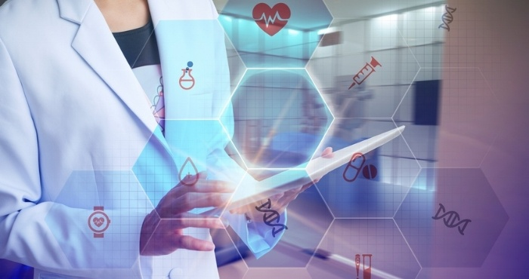
Medical technology has led to the development of equipment that can perform non-invasive surgeries reducing the time required by the patient to heal.
More comfortable scanning devices and systems that enhance better diagnosis and monitoring have also been developed thanks to technology.
Technology plays a prominent role for doing surgeries and diagnosing diseases.
Therefore, advancements in this field will too be extremely helpful in saving more and more lives.

Slide 6
BRAIN
The BRAIN initiative
Transranial Magnetic Stimulisation
Functional Magnetic Resonance Imaging
Stereoelectroencephalography
Magnetoencephalography
Few of today’s new findings

Slide 7
THE BRAIN INITIATIVE
The focus in the first 5 years was on the technology development, then in the second 5 years focus being on integrating technologies to make fundamental discoveries about the brain. Seven goals were identified and articulated with using modern technology:
1) Discovering diversity: identify and provide experimental access to the different brain cell types to determine their roles in health and disease;
2) Maps at multiple scales: generate circuit diagrams that vary in resolution from synapses to the whole brain;
3) The brain in action: produce a dynamic picture of the functioning brain by developing and applying improved methods for large-scale monitoring of neural activity;
4) Demonstrating causality: link brain activity to behaviour with precise interventional tools that change neural circuit dynamics

Slide 8
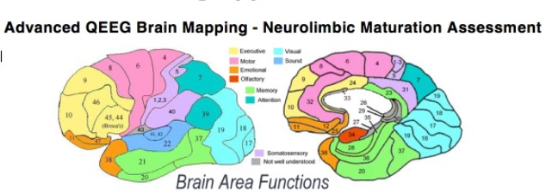
5) Identifying fundamental principles: produce conceptual foundations for understanding the biological basis of mental processes through development of new theoretical and data analysis tools
6) Advancing human neuroscience: develop innovative technologies to understand the human brain and treat its disorders and create and support integrated human brain research networks
7) From BRAIN Initiative to the brain: integrate new technological and conceptual approaches produced in goals 1–6 to discover how dynamic patterns of neural activity are transformed into cognition, emotion, perception, and action in health and disease.

Slide 9
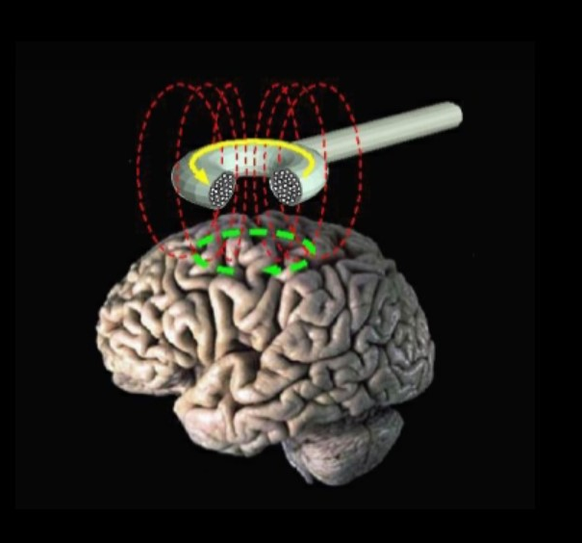
TRANSCRANIAL MAGNETIC STIMULISATION
TMS is a non-invasive method (outside procedure) of brain stimulation. It is a medical device which applies electrical pulses to the brain using a magnetic coil held over the head.
An electric current is delivered to the coil by a stimulator, and the current flowering through loops in the coil generates a magnetic field.
The magnetic field goes through the head to the brain painlessly, where it produces an electrical stimulation of a specific pattern, focused on an area of the brain.

Slide 10
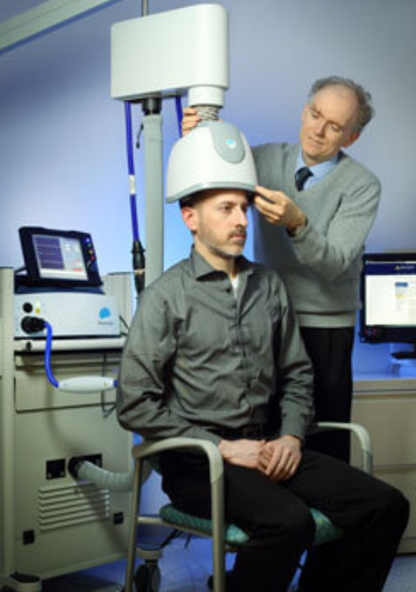
The coil generates brief magnetic pulses, which pass easily and painlessly through the skull and into the brain.
These patterns can produce long lasting changes in brain activity which can be used to treat neurological and psychiatric disorders.
TMS has shown diagnostic and therapeutic potential in the central nervous system with a wide variety of disease states in neurology and mental health, with research still evolving.

Slide 11
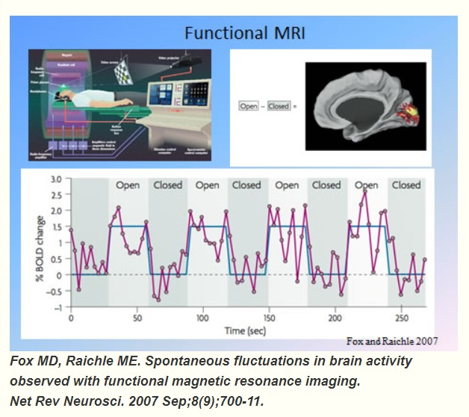
FUNCTIONAL MAGNETIC RESONANCE IMAGING
Functional magnetic resonance imaging (fMRI) measures the small changes in blood flow that occur with brain activity.
It may be used to examine the brain's anatomy, (determine which parts of the brain are handling critical functions), evaluate the effects of stroke or other diseases, or to guide brain treatment.
fMRI helps detect abnormalities within the brain that cannot be found with other imaging techniques.

Slide 12
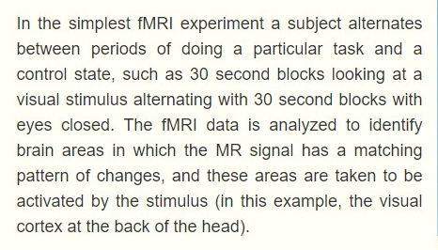
Physicians perform fMRI to:
examine the functional anatomy of the brain.
determine which part of the brain is handling critical functions such as thought, speech, movement and sensation, which is called brain mapping.
help assess the effects of stroke, trauma, or degenerative disease (such as Alzheimer's) on brain function.
monitor the growth and function of brain tumors.
guide the planning of surgery, radiation therapy, or other invasive treatments for the brain.
EXPERIMENT PERFORMED WITH FMRI

Slide 13
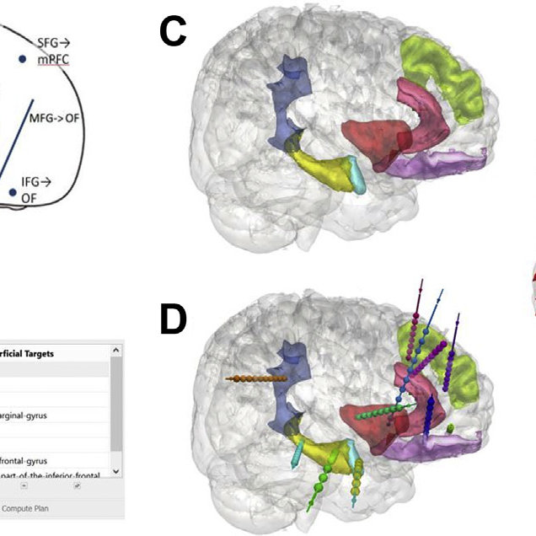
STEREOELECTROENCEPHALOGRAPHY
It is the practice of recording electroencephalographic signals via depth electrodes (electrodes surgically implanted into the brain tissue). It may be used in patients with epilepsy not responding to medical treatment, and who are potential candidates to receive brain surgery in order to control seizures caused by the disease.
Doctors place electrodes in targeted brain areas, which are then monitored to precisely locate seizure source.
When the seizure onset is localized, the seizures can be bought in control.
SEEG can cover larger brain areas and, very importantly, it can be used to monitor both sides of the brain. Until now, when seizures were coming from both hemispheres, we could do nothing to localize them.

Slide 14
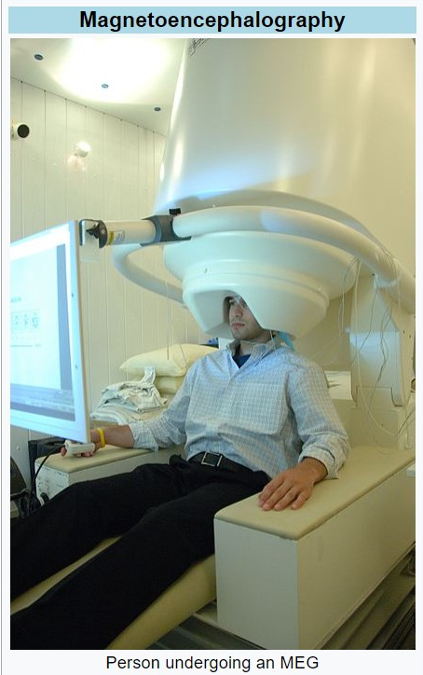
MAGNETOENCEPHALOGRAPHY
MEG is a functional neuroimaging technique for mapping brain activity by recording magnetic fields produced by electrical currents occurring naturally in the brain, using very sensitive magnetometers.
Superconducting quantum interference devices are currently the most common magnetometer.

Slide 15
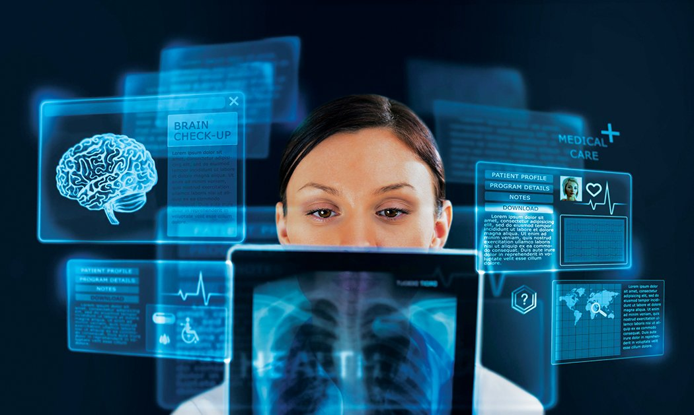
Applications of MEG include basic research into perceptual and cognitive brain processes, localizing regions affected by pathology before surgical removal, determining the function of various parts of the brain, and neurofeedback.
MEG can resolve events with a precision of 10 milliseconds or faster, while functional MRI (fMRI), which depends on changes in blood flow, can at best resolve events with a precision of several hundred milliseconds. MEG also accurately pinpoints sources in primary auditory, somatosensory, and motor areas.
It is also being used to better localize responses in the brain.

Slide 16
FEW OF TODAY'S NEW FINDINGS SHOW THAT:
Transcranial magnetic stimulation improves how well older adults recall object locations, providing a possible path for limiting age-related memory loss (John A. Walker)
Transcranial focused ultrasound affects deep brain regions and influences primate behaviour, suggesting its potential use in treating neurological disorders (Jan Kubanek)
A portable headset can target transcranial focused ultrasound to excite deep brain regions in sheep, a first step toward stimulating specific brain regions in awake, moving animals (Seung-Schik Yoo)
A brain stimulation system that simultaneously monitors and activates neurons in mice allows more targeted control of brain activity based on real-time neural changes (Noah Young)
An adaptable deep brain stimulation device can auto-adjust its level of stimulation based on the severity of involuntary movement in Parkinson's disease, allowing for better management of symptoms and side effects (Nicole C. Swann)

Slide 17
EYES
Eye surgery always progresses the same way as science advances.
New emerging technologies such as: bio-printing in 3D, mathematical modeling, and developments in prototyping lab-on-a-chip, visual implants, and new biopolymers have started to be used in eye enucleation.
The detection of eye biomarkers at the cellular level, bio-sensors, and new diagnostic tests that are considered to improve the quality of life of patients after surgery.
The term “emerging technologies” refers to the implementation of new innovative products designed to improve the quality of life.
Some acronyms used are:
NBIC: Nanotechnology, Biotechnology, Information technology, and Cognitive science.
GNR: Genetics, Nanotechnology, and Robotics.
GRIN: Genetic, Robotic, Information, and Nanotechnology.
BANG: Bits, Atoms, Neurons, and Genes.

Slide 18
Eye surgery has always been characterized by innovation, the introduction of new surgical techniques, and also the inclusion of technology.
But being so specialized, this information is not readily disclosed to the targeted patients who directly require these new developments in order to restore their vision or improve the quality of their life.
Otherwise, medical students and residents in ophthalmology require an overview of these new developments to plan the training for these new techniques and apply it to patients that have these requirements according to the new protocols, inclusion criteria, and the available technology in the operating room in order to plan new investments for clinical practice and training.
Knowing where you are in making this progress, communication and the creation of partnerships between experts are priorities to be able to respond to the patients’ needs.

Slide 19
10 VISION SAYING ADVANCES IN MEDICINE
01
02
03
Corneal Inlay May Soon Replace Reading Glasses.
04
For Glaucoma, Diamonds May Help Prevent Vision Loss
05
HIV Meds for Macular Degeneration
Printing New Eyes
Gene Therapy for Vision Loss

Slide 20
10 VISION SAYING ADVANCES IN MEDICINE
06
07
08
Dr TV: Diagnosing Glaucoma
09
Implant May Reduce Office Visits
10
Smartphone Eye Exams
A Sharp Eye Drop Replacement
Apps for the Blind

Slide 21
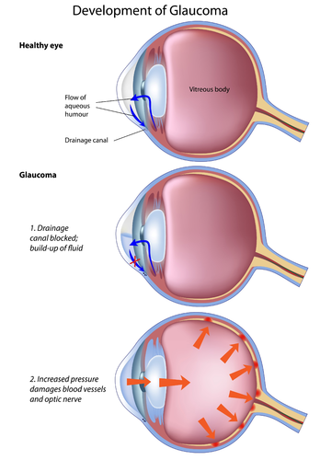
EARLIER DETECTION OF GLAUCOMA AND CONTRACTIONS
Recent technological developments in eye care have helped improve treatments for cataracts sufferers and detection of on-setting glaucoma.
Knife-free treatments for cataract surgery are more accurate and safer than ever before, ensuring a speedier recovery too.
The next generation could experience implants directly into the eye through gene and stem cell therapy to help detect glaucoma symptoms and the type of glaucoma in everyone.
Ultimately, it’s hoped that technology can be used as a force for good in improving eye health and maintaining their function for longer than ever.
Much of the concepts we’ve discussed are still very much in their infancy and trial stages, but it’s certainly a “watch this space” moment for the eyecare sector.

Slide 22
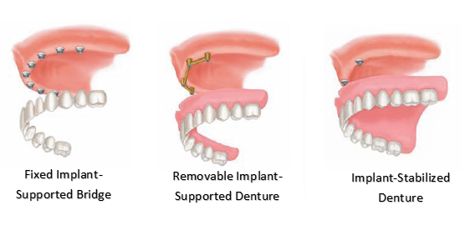
TEETH
Computer-aided design (CAD) and computer-aided manufacturing (CAM) are new technologies that allow dental technicians to create new dentures out of material discs in a fraction of the time.
01
02
03
04

Slide 23
THE NEW ADVANCEMENTS IN THIS FIELD ARE:
3D Printing
01
Robotic Dental Implant Surgery
02
Continuous Liquid Interface Production
03
Intra-Oral Camera
04

Slide 24
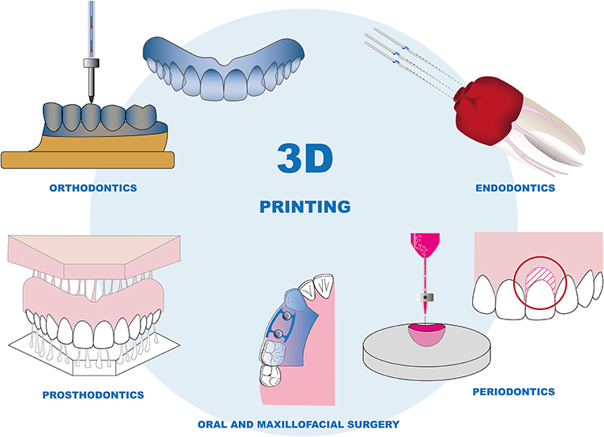
3D PRINTING
A 3D computed guided implant placement process will change the way that you look at implants and oral surgery.
A 3D Digital Impression is also taken of the area with the missing teeth to plan the position and size of the future implant crown.
This allows us to perfectly place an implant in a fraction of the time without the need for a surgical incision.
04

Slide 25
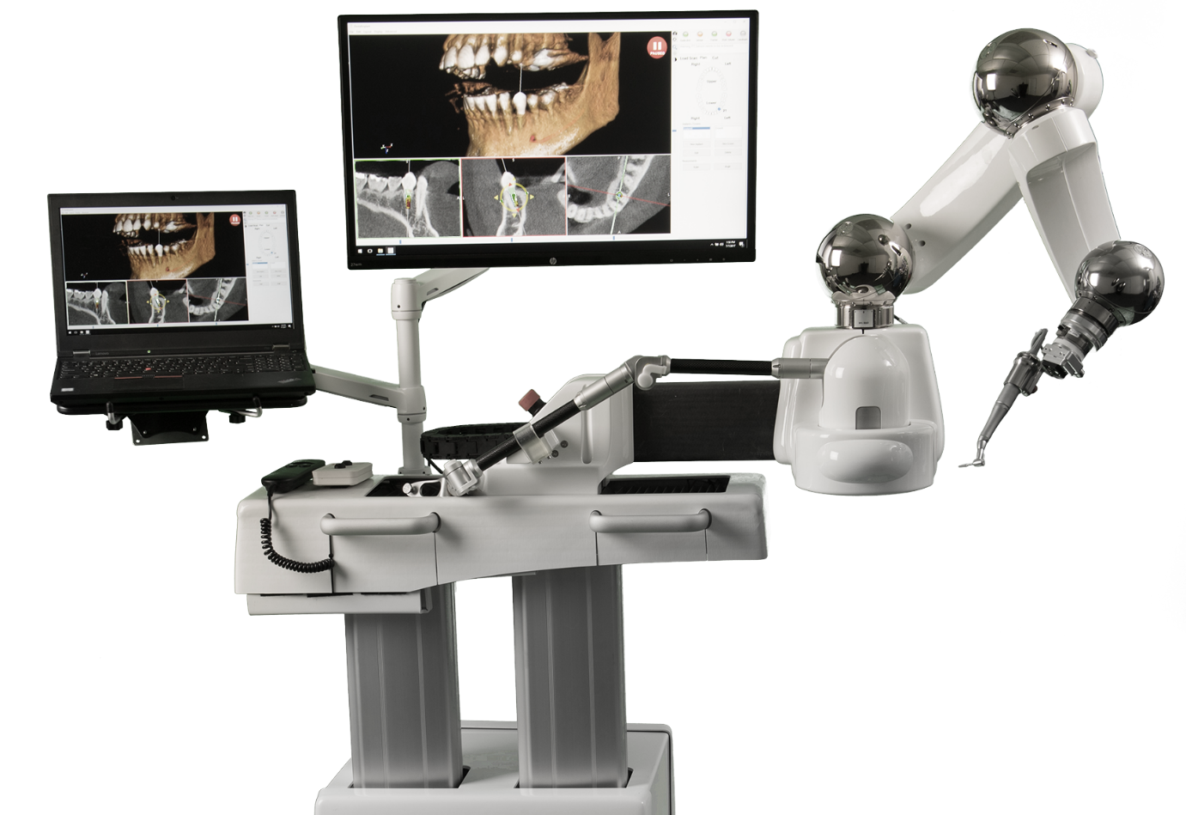
ROBOTIC DENTAL IMPLANT SURGERY
Dental Implants are one of the leading ways dentists help patients restore teeth that would otherwise be lost to decay.
Modern dentistry relies heavily on plastic drill guides when placing a dental implant, but that is all changing.
With this new technology, a computerised navigational program provides sensory information and holds the drill in position.
Robotic dental implant surgery can aid in both preoperative and surgical stages.
04

Slide 26
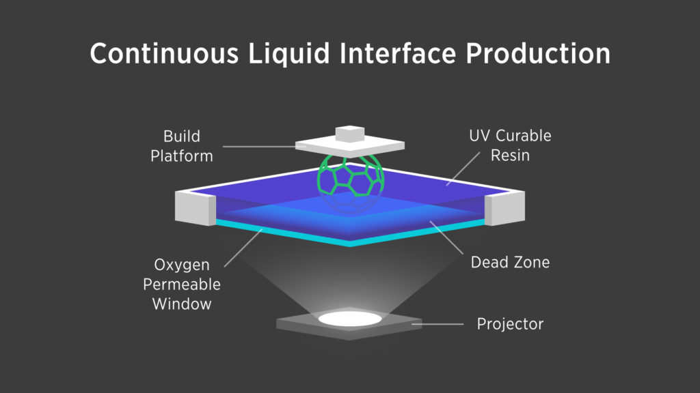
CONTINUOS LIQUID INTERFACE PRODUCTION
3D printing is a slow process, but CLIP could make the process much faster for dentists.
The amount of time 3D printing takes is largely due to the steps a 3D printer must take to replenish materials, cure those materials, and reposition itself.
Continuous Liquid Interface Production allows a solid object to grow out of a liquid bath.
04

Slide 27
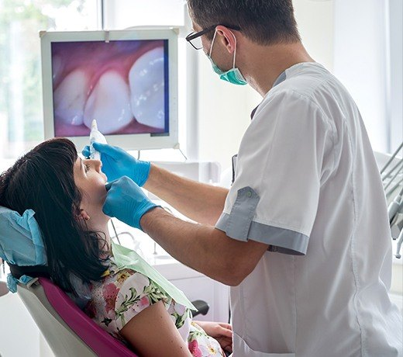
Intra-Oral Camera
This technology enables you to explore the inside of a patient’s mouth using a mirror with a small camera in it.
Here we does no longer need stretch lips back or ask patients to keep their jaws open for long periods. This tool also allows you to see problem areas much more clearly.
Designed to allow clinicians to capture and display digital images from inside a patient’s mouth, intraoral cameras are a valuable tool for patient education and case documentation.
Shaped like a small wand, many dental intraoral cameras are highly portable and easily connect to a computer wirelessly, via USB or via a docking station.
04

Slide 28
HEART
Wearable Technologies Aid Patient Monitoring
Organ Conformal Electronics
Virtual and Augmented Realty in Cardiology
Personalized heart models to aid surgery
Engineered Heart Valve

Slide 29
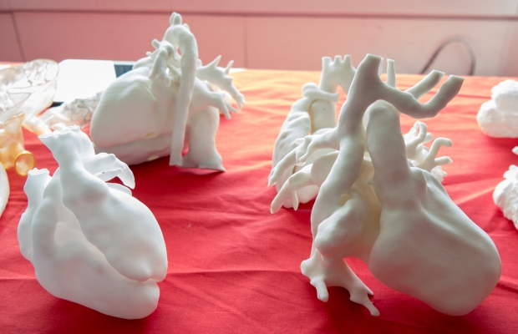
PERSONAL HEART MODELS TO AID SURGERY
Scientists at University College London have created 3D-printed models of the heart from MRI scans of children with congenital heart disease to aid patient communication ahead of surgery.
The patient-specific models help doctors better explain the nature of the heart disorder to patients and their families, who say the 3D models are “incredibly useful” and “realistic and much easier to understand” compared to traditional medical imaging, such as echocardiograms.
01
02
03
04

Slide 30
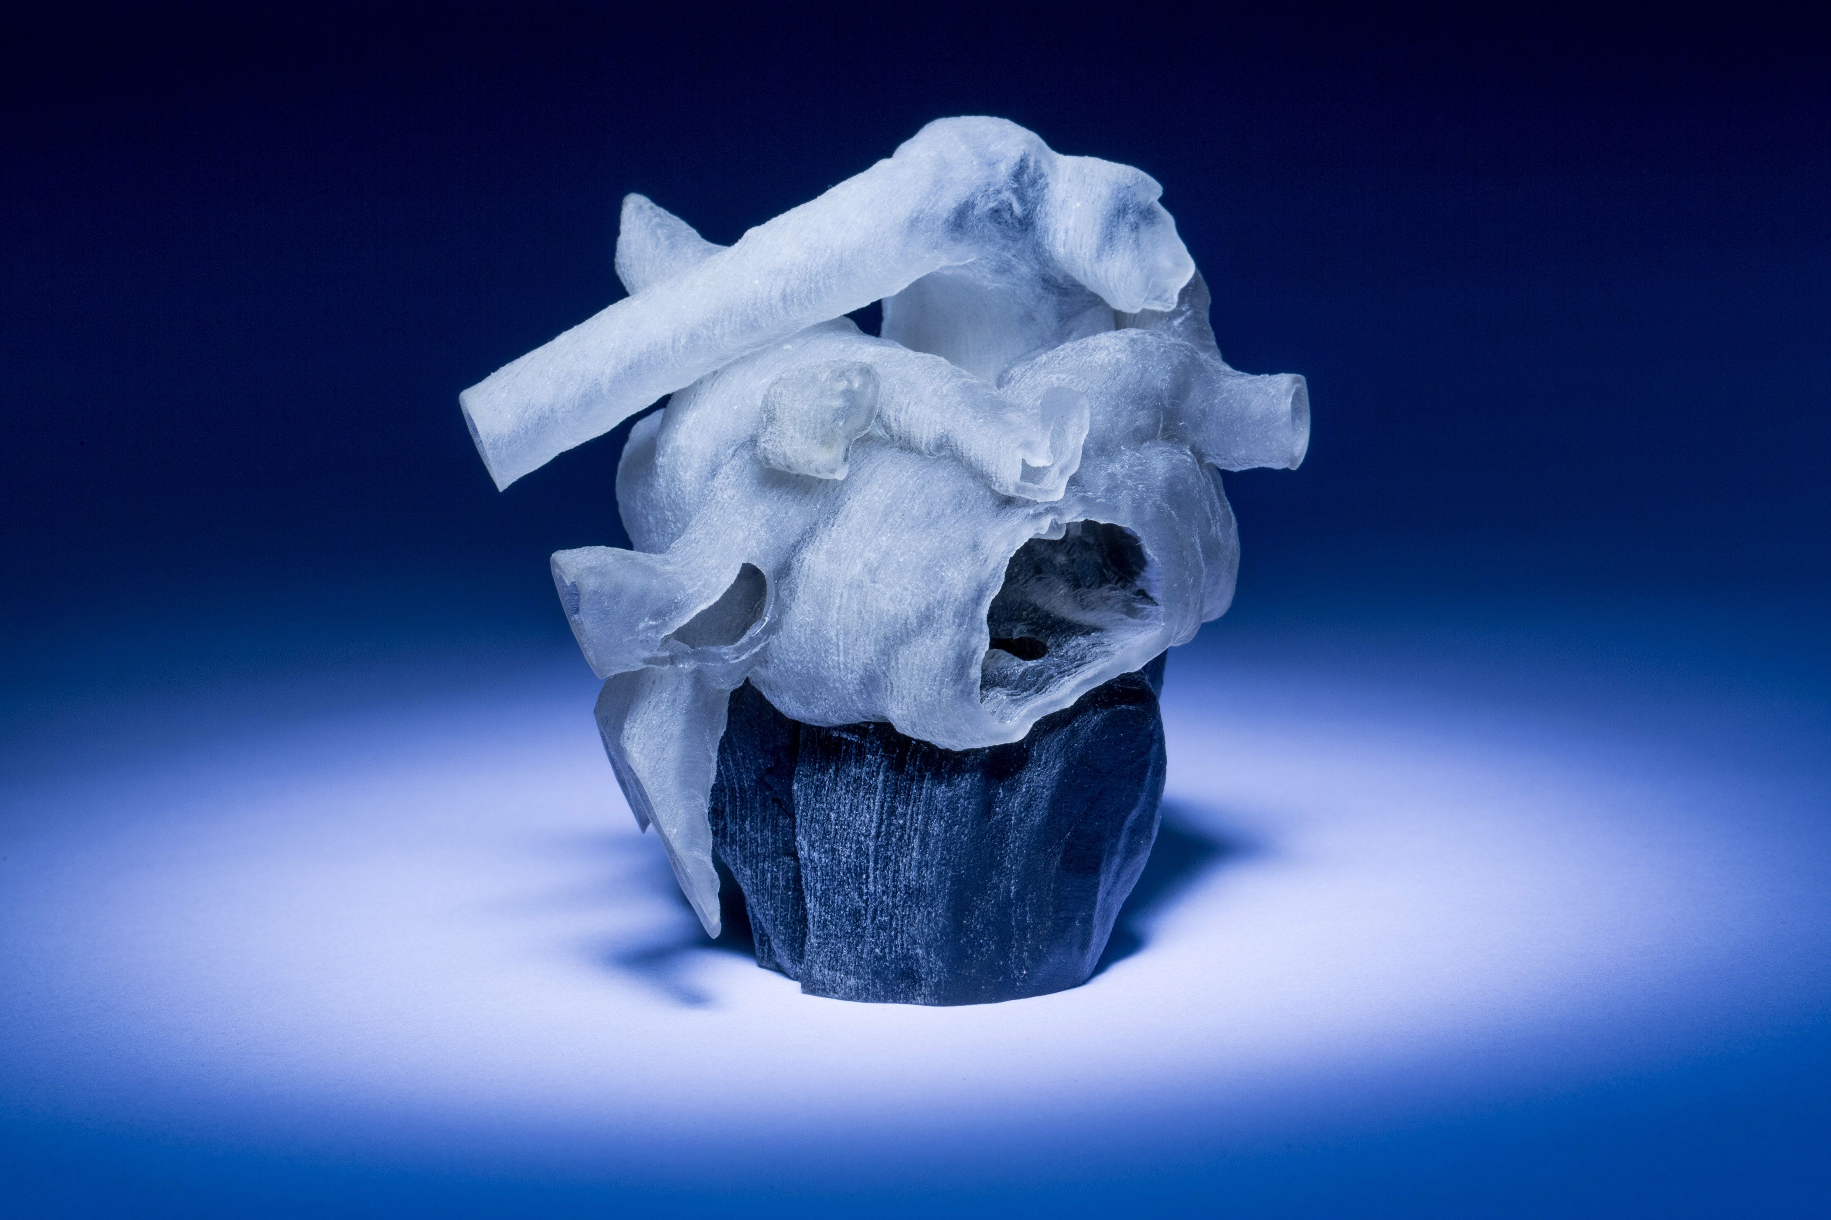
The research team believes this boosts parents’ understanding of the condition and helps them engage with the surgical team.
The same team is working with Great Ormond Street Hospital to produce computer stimulations to plan surgery for children born with heart defects.
They hope that this personalised approach will help surgeons work with families to decide on the best treatment for the child.
01
02
03
04

Slide 31
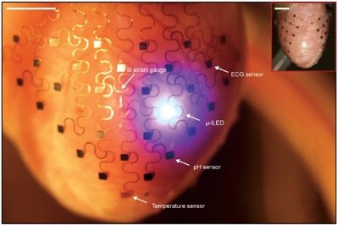
ORGAN CONFORMAL ELECTRONICS
Conformal electronics are flexible, stretchy, electronic devices that can diagnose and treat tissue malfunctions.
They have high spatiotemporal resolution and are comprised of a system of various sensors and transducers.
Conformal electronics assess multiple parameters to monitor and regulate cardiac tissue functions by following the shape of the epicardium or endocardium.
The technology of conformal electronics can transform the current model of cardiac diagnostics and therapeutics by enabling the development of new equipment.
Also, new minimally invasive methods to access the epicardial tissue are likely to facilitate clinical adoption of this technology.
01
02
03
04

Slide 32
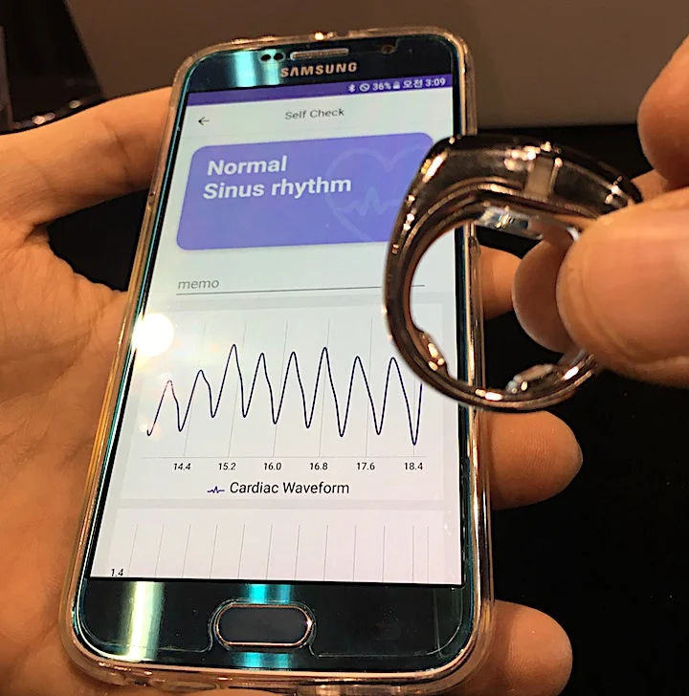
WEARABLE TECHNOLOGIES AID PATIENT MONITORING
Smart software and AI is being incorporated into the wearable and app algorithms to detect abnormally high heart rates, arrhythmias, and other factors to alert patients to contact their doctors.
This consumer-grade early warning network will likely play a big role in the coming years to automatically triage patients and help know when they should seek professional healthcare help.
A large number of healthcare systems are integrating wearables into their remote patient monitoring programs.
01
02
03
04

Slide 33
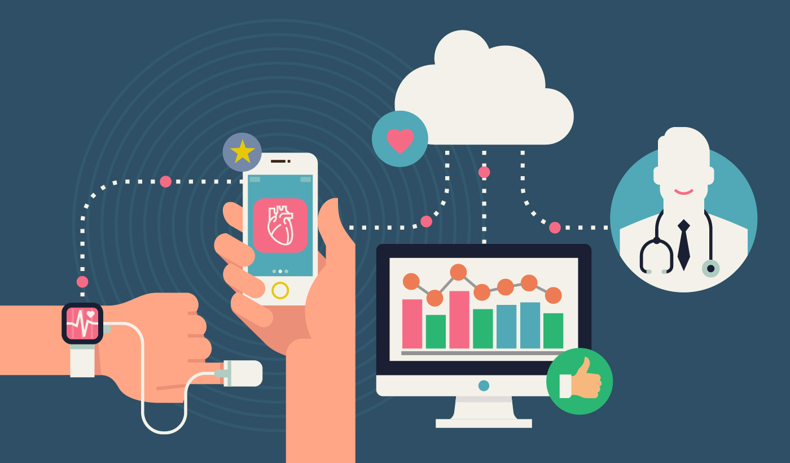
In some cases, professional grade wearables, like inexpensive stick-on ECG monitors now offered by several vendors, are replacing traditional Holter monitors.
Some hospitals are using wearables and consumer-grade devices like glucose monitors, wireless scales and blood pressure monitors that interface with smartphone apps to track cardiac rehabilitation, and diabetic and heart failure patients remotely.
01
02
03
04

Slide 34
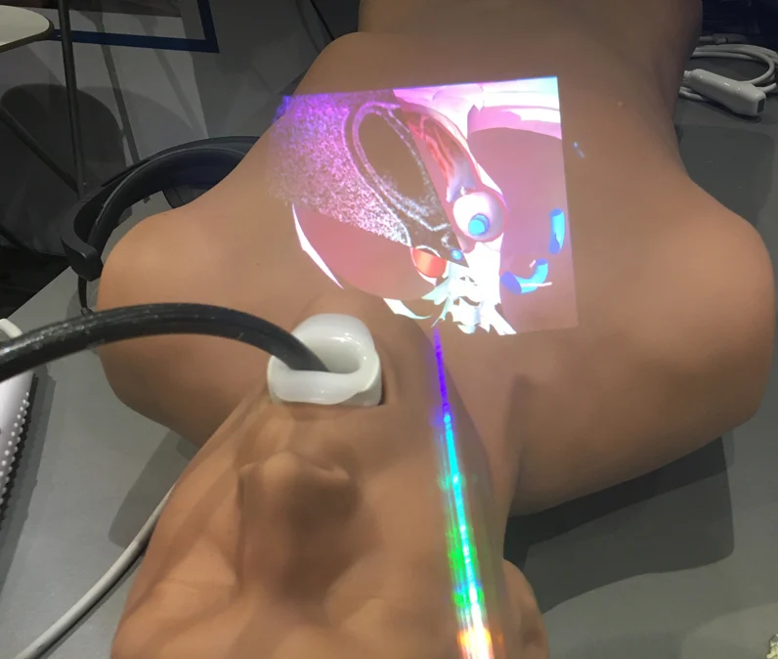
VIRTUAL AND AUGMENTED REALITY IN CARDIALOGY
Boston Scientific is using VR headsets with pre-loaded live electrophysiology device implant cases, which offer a 360 degree view of the EP lab and the procedure as a key opinion leader offers his advice and explains what they are doing during the case.
This virtual physician proctoring may help speed up the transfer of how-to knowledge and patient access to new EP technologies. Abbott uses a virtual reality simulator to train interventional cardiologists how to use its intravascular optical coherence tomography (OCT) imaging technologies to exam at lesions in the coronary arteries, or create 3-D renderings of the disease vessel segments.
01
02
03
04

Slide 35
The training in the VR headset puts the operators into a virtual cath lab with a 360 degree of the room and equipment to perform the imaging.
NovaRad has FDA clearance on the first surgical AR system.
The surgeon wears an augmented reality headset and they can superimpose and co-register a CT or MRI dataset onto a patient on the OR table.
They can then virtually slice through the patient to pre-plan the procedure and mark their skin for incisions based on being able to to the underlying tissues.
01
02
03
04

Slide 36
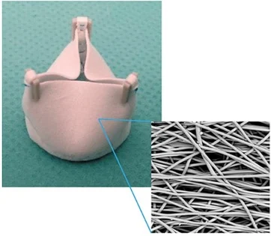
ENGINEERED HEART VALVE
The global burden of congenital or acquired heart valve defects is high.
Bioprosthetic or mechanical replacement valves are often used, although they have limitations. This is especially true for pediatric patients who continue to grow.
A potential solution is developing an in situ tissue engineering approach.
A synthetic, bioresorbable scaffold might lead to individualized replacements for heart valves. These might be less prone to infections and more suitable for pediatric populations.
01
02
03
04

Slide 37
BONES
01
Robotic Surgeries
Haptic Robotic Systems
Autonomous Robotics Systems
02
Orthobiologic Technology
03
Smart Sensor-Enabled Technologies and Implants
04
3-D Printing Technologies

Slide 38
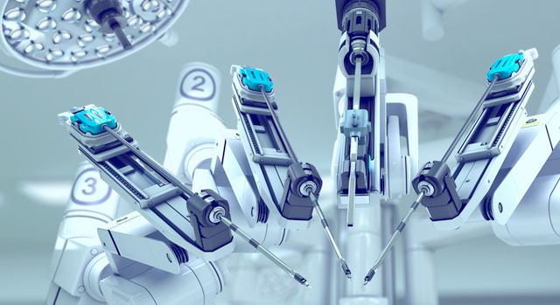
ROBOTIC SURGERIES
Two systems for Robotic Surgery exist: 1)Autonomous 2) Haptic (Tactile) System
Haptic systems allow the surgeon to drive, or use the robot to perform the operation
Constant input of the surgeon is mandatory for efficient functioning of the system
In autonomous systems, the surgeon performs the approach, sets up the machine and then engages the robot to complete the surgery without the surgeons help
01
02
03
04

Slide 39
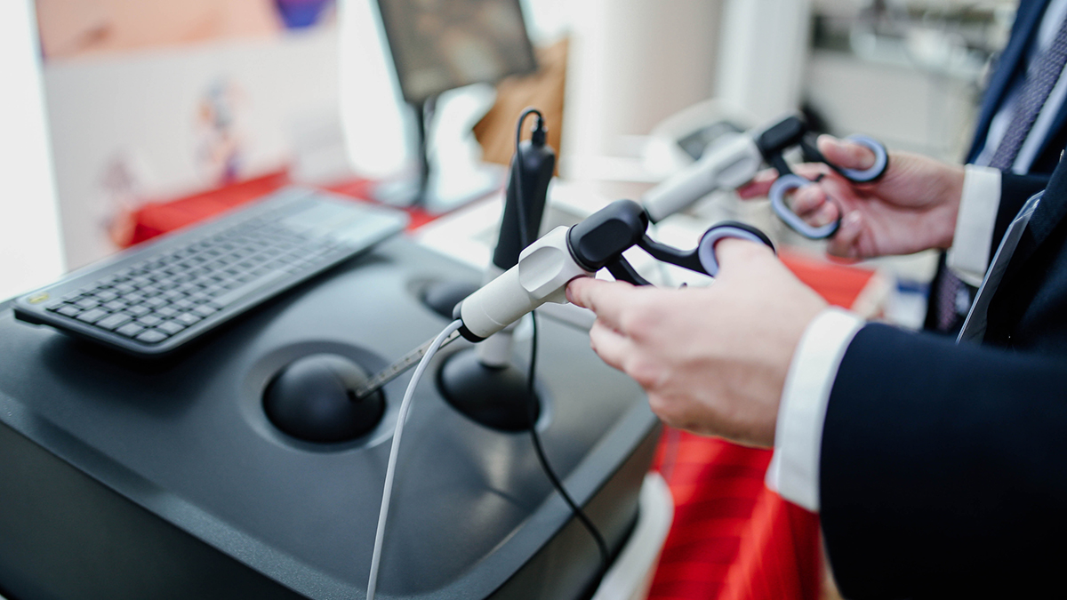
HAPTIC ROBOTIC SYSTEMS
Surgeon will intraoperatively mark the bony surfaces of the femur and tibia allowing the preoperative model to be merged into the active anatomy of the knee.
The knee is taken through a full range of motion, the flexion-extension gaps assessed, component size and implant placement finalized and a cutting zone is created for the robot.
The system’s algorithm is wholly based on the preoperative planning and templating
01
02
03
04

Slide 40
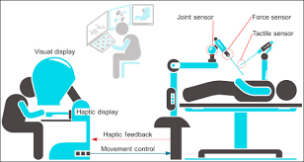
01
02
While manipulating the burr, for resection of bone, the surgeon can view the 3D model on the monitor
Resection of bone is confined to the predefined cutting space on the forced controlled tip of the rotating burr
In any case if the surgeons goes beyond the cutting zone, the safety system automatically stops the burr
03
04

Slide 41
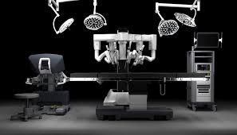
AUTONOMOUS ROBOTIC SYSTEMS
Autonomous robotic systems complete the surgery without assistance of a surgeon
Though the robot operated independently, the surgeon is in control of an emergency shut-off switched.
01
02
03
04

Slide 42
ROBODOC was such a system that was developed in the 1980s and was introduced into surgical practice in 1992(Curexo Technology, California)
ROBODOC was very popular in Germany with many trials conducted in THA demonstrating good component positioning, but soon fell into disrepute amidst safety concerns
A hybrid system has been developed in Carnegie Mellon University, Pittsburgh, Pennsylvania
In this system the Mini Bone Attached Robotic System(MBARS), mounts on to the femur and completes the bony resection in TKR
Praxiteles (Praxim, France) is another similar robotic system developed in France.
01
02
03
04

Slide 43
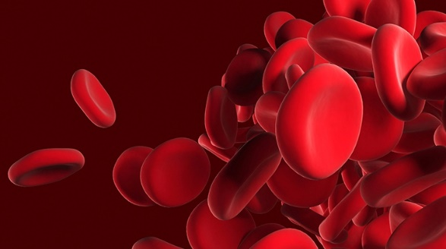
ORTHOBIOLOGIC TECHNOLOGY
Orthobiologics harness the regenerative potential of the cells in the human body.
Orthobiologics are made from substances naturally found in the body and are used to improve the healing of broken bones and injured muscles, ligaments and tendons.
They include bone grafts, growth factors, stem cells, platelet-rich plasma, autologous blood, and autologous conditioned serum.
The mesenchymal stem cells (MSCs) found in bone marrow have proved to be effective in the development of the desired tissues.
01
02
03
04

Slide 44
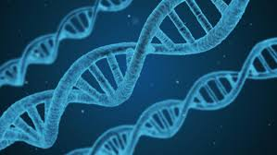
Recent innovations in this field, including growth factor and stem cell-based strategies, will lead to faster recoveries.
Another innovation is drug-eluting bone grafts, which can be used to deal with problems such as orthopedic surgical infection.
Clinical studies show that growth factors can accelerate the healing process
01
02
03
04

Slide 45
SMART SENSOR-ENABLED TECHNOLOGIES AND IMPLANTS
Smart implants have embedded sensors that provide real-time information to surgeons for positioning and post-operative evaluation for better patient care throughout the treatment pathway.
These implants have the potential to reduce periprosthetic infection, which is a growing problem in orthopedic practice.
Sensor-enabled technologies have given health care providers a choice of unique, cost-effective products.
Companies that operate in this space include Zimmer Biomet and OrthoSensor, which entered into a co-marketing partnership for smart implants. Stryker and OrthoSensor are working on a smart knee implant to optimize joint balance during total knee arthroplasty.
01
02
03
04

Slide 46
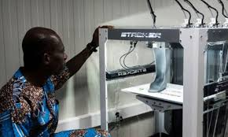
3-D PRINTING TECHNOLOGY
One important benefit of 3D printing in the orthopedic field is for testing and planning purposes.
The ability to test treatments or implants on exactly accurate models is important.
Orthopedic surgeons can use 3D printed models to plan their surgery better, and even can use it during surgery for guidance.
Some surgeons will even perform the surgery beforehand on the 3D printed model, so they are more ready for the actual procedure.
In cases of degeneration, the printed bones can be compared to other anatomical models and the patient’s other bones, so manufacturing of implanted parts can be better guided.
Printing 3D replicas of deformed feet and ankles can greatly assist in surgery
01
02
03
04

Slide 47
INTERNAL ORGANS
01
Liver
02
Stomach
03
Kidney
04
Pancreas

Slide 48
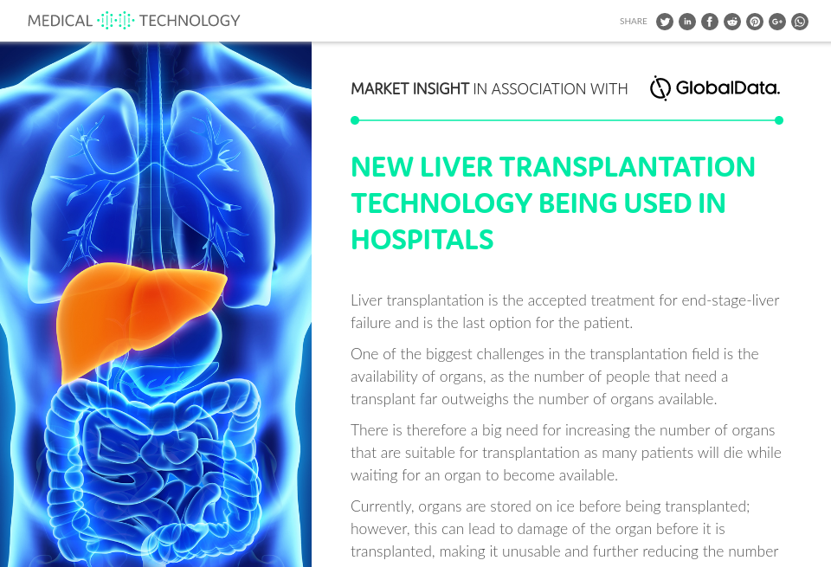
LIVER
Due to technological advancement,a infected or a serotic liver can replaced with a healthy liver.
History of one such patient with infected liver has many parameters to be observed and stored as patients health profile.
On receiving a healthy donor liver, it becomes convinient and fast to match the parameters of receiving patient.
01
02
03
04

Slide 49
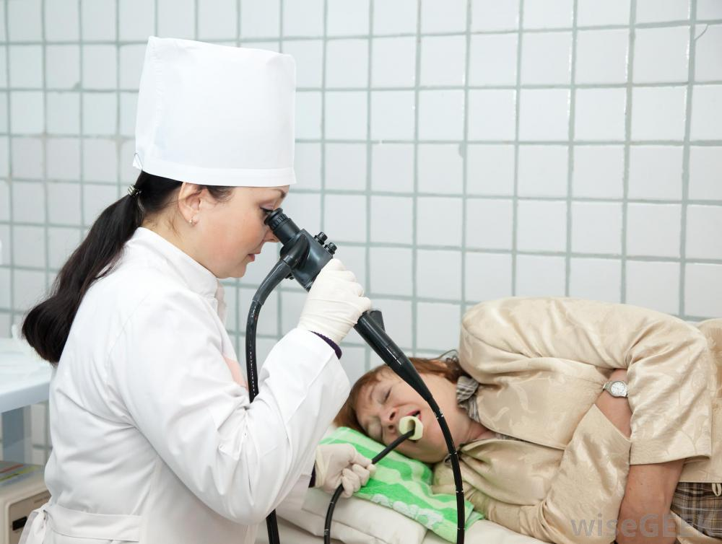
STOMACH
It is one of the vital organ(internal) in human anatomy.
Endoscopy, one of the best technological advancement helps medical professionals to diagnose and treat many diseases like ulcers, internal haemorrhage and many other associated diseases.
Bariatric surgery is a surgery which is perfomed laparoscopically to reduce size of the stomach vertically.
This helps the patient with high bmi(body mass index) to loose weight.
It is a very good example of technological advancement in medical field.
01
02
03
04

Slide 50
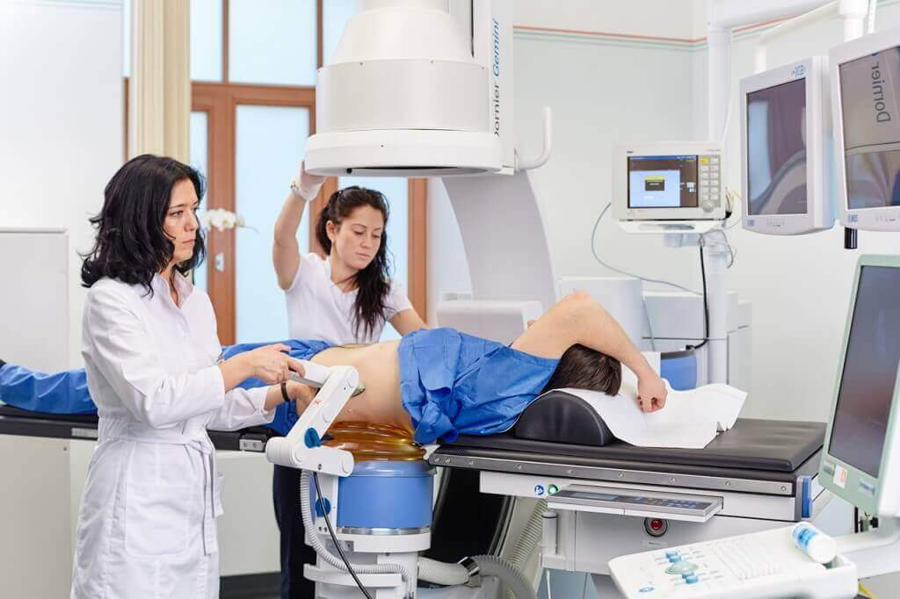
KIDNEY
Many individuals have a medical complaint of kidney stone or urethral stone.
Lithotripsy, another technological advancement helps such patients to get relief without any invasive prodecure.
It is a procedure that uses shock waves to break up stones in the kidney and parts of the ureter.
The broken particles are then excreted through urine.
01
02
03
04

Slide 51
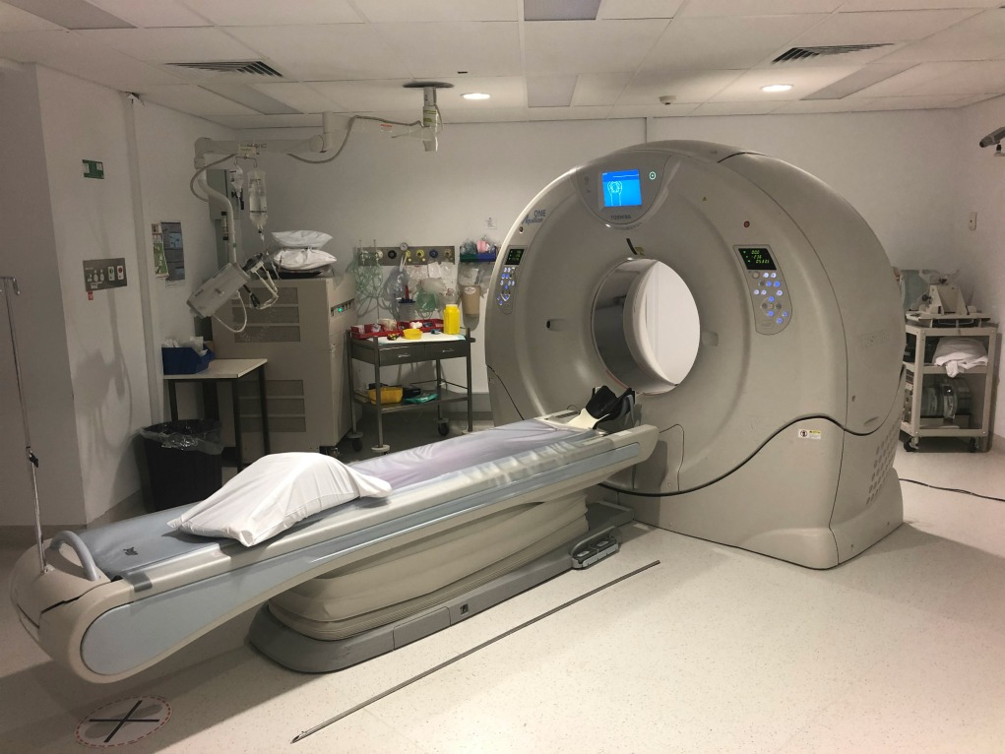
PANCREAS
Pancreatitis is inflamation in the pancreas.sometimes pancreatitis is also caused by a narrowed or blocked bile duct.
Latest techniques like ct scan,mri or ultrasound of abdomen helps to diagnose pancreatitis.
A procedure called endocopic reprograde cholangio pancreto graphy(ercp) uses a long tube with a camera on the end to examen pancreas and bile ducts.
01
02
03
04

Slide 52
THANK YOU

